Slide 1

GOVERNMENT ARTS AND SCIENCE COLLEGE
PERUMBAKKAM.
BACHELOR OF COMPUTER SCIENCE

Slide 2

EARLY PREDICTION FOR CHRONIC KIDNEY DISEASE DETECTION A PROGRESSIVE APPROACH TO HEALTH MANAGEMENT
PRESENTED BY
HARIHARAN.K
DHANUSH CHANDRAN.R
SATHISH KUMAR.S
SUNDAR.A

Slide 3
INTRODUCTION:
WE CREATE A MACHINE LEARNING PROGRAM TO IDENTIFY THE PRORGAM OF CHRONIC KIDNEY DISEASE(CKD)
CKD IS A MAJOR MEDICAL PROBLEM AND CAN BE CURED IF TREATED IN THE EARLY STAGES
PURPOSE OF THE PROJECT:
THAT WE PREDICT THE PROBLEM IN SHORT TIME SO WE SAVE THE PATIENT LIVE FROM RISK

Slide 4
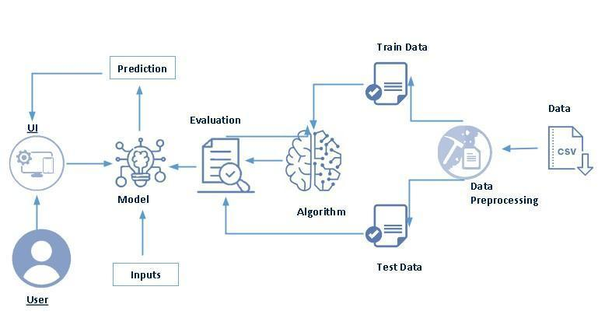
TECHNICAL ARCHITECTURE:
THIS DIAGRAM REPRESENT THE PROJECT FLOW OF THE CHRONIC KIDNEY DISEASE

Slide 5
PROBLEM STUDIES:
CHRONIC KIDNEY DISEASE(CKD) IS A MAJOR MEDICAL PROBLEM AND CAN BE CURED IF TREATED IN THE EARLY STAGES
SYMPTOMS:
CONTINIOUS URINE PROBLEM
SMALLER KIDNEY SIZE

Slide 6
TYPES OF KIDNEY DISEASE:
DIABETES
BP(BLOOD PRESSURE)
PALYSISTIC KIDNEY DISEASE
GLOMERULONEPHRETS
DATA COLLECTION & PREPARATION:
TO COLLECT MANY PATIENT CASE DETIALES ABOUT THE DEASISE IN VARIOUS HOSPITALS AND USE IT FOR SOFTWARE DEVELOPEMENT

Slide 7
* SEARCH FOR SIMILAR SOFTWARS AND TAKE THE BETTER INVENTED IDEAS IN THE SOFTWARE AND USE & UPGRADE IT
* GIVE A FULL THEORITICAL INFORMATION TO THE PATIENT TO GET A IDEA ABOUT THE DIALISIS
* ADD ADDITIONAL FEATURES IN THE SOFTWARE LIKE WHAT THEY DO AND WHAT THEY DON'T DO BEFORE AND AFTER DIALISIS

Slide 8
MODULE BUILDING:
TRAINING THE MODEL IN MULTIPLE ALGORITHM
ANN MODEL
RANDOM FOREST MODEL
DECISION TREE MODEL
LOGISTIC REGRESSION
TESTING THE MODEL

Slide 9
BENIFITES OF CKD MECHINE LEARNING:
* IT IS THE MOST ADVANCED AI MODEL TO IDENTIFY THE KIDNEY PROBLEMS
* IT IS MORE HELP TO AVOID PATIENTS RISK ZONE FROM THE DISEASE
* IT GUIDE THE PATIENTS AND DOCTORS TO COMPLETELY RECTIFY THE PROBLEM OF CKD

Slide 10
THANK YOU

